Slide 1
English Language Exam: Unit 1
Understanding and producing non-fiction texts
Revision Day: June 2015

Slide 2
2 hour exam + 15 minutes reading and annotation time
1 hour on each section – don’t run out of time for Section B! Q6 is worth 1/3 of the marks for this paper.
60% of your GCSE grade

Slide 3
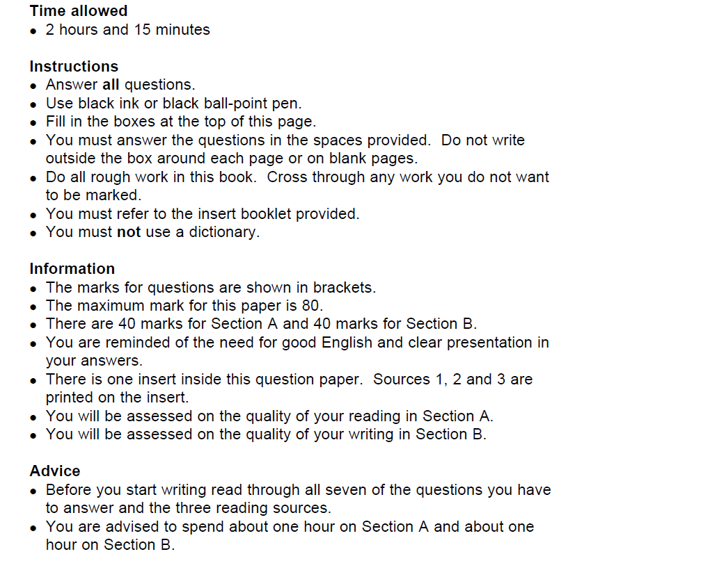
15 MINS READING TIME + 1 ½ MINUTES PER MARK
(8 MARKS = 12 MINUTES)
DON’T LEAVE ANY BLANKS!
USE QUOTATIONS; ALL OF THE INFORMATION IS IN THE TEXTS
REMEMBER TO QWERTY THE LANGUAGE AND PRESENTATION QUESTIONS

Slide 4
SECTION A: READING – Assessment Objectives
Read and understand texts, selecting material appropriate to purpose, collating from different sources and making comparisons and cross-references as appropriate.
Explain and evaluate how writers use linguistic, grammatical, structural and presentational features to achieve effects and engage and influence the reader.
These skills are the same as those needed to produce your CAs!
Understanding what you read
Selecting quotations
Comparing texts
Explaining how a writer uses language and structure to effect and influence a reader
The only new element is presentational devices.

Slide 5
So you think a 2 ¼ hour exam is tough…

Slide 6
Question 1: What do you understand about the issues…
Source 1 purpose: to inform, explain and argue.
KEY SKILLS
Select and retrieve main points
Interpret the writer’s ideas and attitudes towards the issues discussed
Support your points with short, embedded quotations
Spend 12 minutes on this question
Key words: “understand”; “issues”
Show that you ‘get’ the writer’s argument/ view

Slide 7
Question 1: What do you understand about the issues…
REMEMBER TO:
Pick out 3-4 issues
Put ideas into your own words, using different words than the ones in the quotes you select (synonyms)
Sentence openers:
“One of the issues the writer presents is…”
“Another issue is…”
“Furthermore, the writer suggests…”
“On the other hand…”
“Finally….”
TOP TIP
Always read the whole text. The ending often offers an alternative view, or a nice summary.

Slide 8
Question 1…
Question 1: What do you understand about the issues of Davina’s Sports Relief challenge?
8 marks
12 minutes

Slide 9
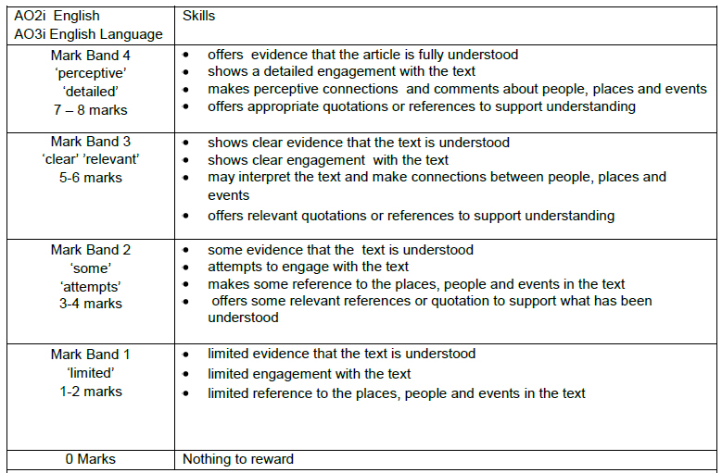

Slide 10
Question 2: ¹Explain how the headline and picture are effective and ²how they link to the text
Source 2 purpose: to inform, explain.
KEY SKILLS
To analyse (look in detail at) presentational features and their effects on the reader
To make links to the main text
Spend 12 minutes on this question
Explain headline
Link headline to text
Explain picture
Link picture to text
Key words: “explain”; “effective”

Slide 11
Question 2: ¹Explain how the headline and picture are effective and ²how they link to the text
Source 2 purpose: to inform, explain.
REMEMBER TO:
Pick out 2-3 specific details about the headline and explain the effect of each; link each point to a quote from the main text
Pick out 2 specific details about the picture and explain the effect of each; link each point to a quote from the main text
TOP TIP
You have to consider both the headline and the picture to get a Band 4 mark. DO NOT link the headline and the picture; there are no marks for this.

Slide 12
Question 2: ¹Explain how the headline and picture are effective and ²how they link to the text
Source 2 purpose: to inform, explain.
Headline Effects Picture
Specific words Connotations Colour
Punctuation for impact Point of view
Sentence structures Adds emphasis to Camera angle
Puns what? Background/ foreground
Alliteration Creates a contrast or
tone / mood
Sentence starters:
“One effective feature is…”
“The use of … is effective…”
“Another effective technique is…”
Link these to details in the text

Slide 13
Question 2: ¹Explain how the headline and picture are effective and ²how they link to the text
8 marks
12 minutes

Slide 14
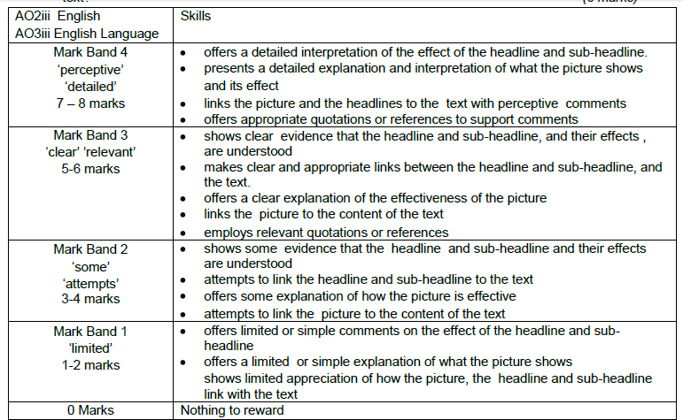

Slide 15
Question 3: Explain some of the thoughts and feelings the writer has...
Source 3 purpose: to inform, explain and entertain – expect descriptive writing!
KEY SKILLS (Same as Q1!)
Select and retrieve main points
Interpret the writer’s/narrator’s thoughts and feelings
Support your points with short, embedded quotations
Spend 12 minutes on this question
Show you understand the thoughts and feelings expressed by the writer and how these are communicated in the text.
Key words: “explain”; “thoughts/ feelings”

Slide 16
Question 3: Explain some of the thoughts and feelings the writer has...
Source 3 purpose: to inform, explain and entertain – expect descriptive writing!
REMEMBER:
Do not write about effect on the reader here
Instead, explain 1) what are the thoughts and feelings?; 2) why do they feel like this?; 3) how do we know?
Sentence starters:
“At first the writer feels…”
“Later he/she thinks…”
“The writer also feels…”
“This suggests that…”
“The connotations are…”
“It implies…”
TOP TIP
Work chronologically through the text, remembering to look for changing thoughts and feelings: the narrator/writer will go through a transformation of some sort – identify it for higher marks!

Slide 17
Question 3: Explain some of the thoughts and feelings Davina McCall has about her Sports Relief challenge.
8 marks
12 minutes

Slide 18
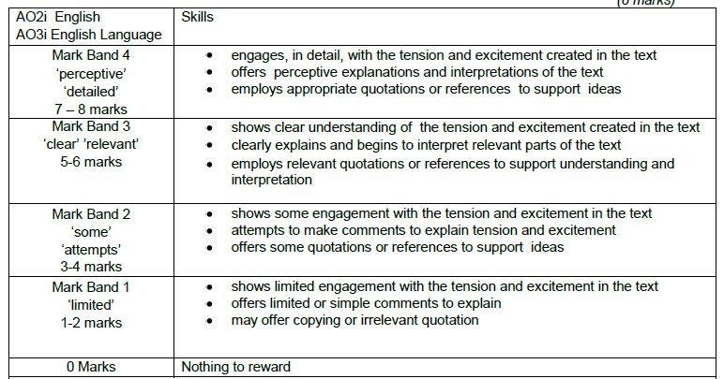

Slide 19
Question 4: Compare the ways in which language is used for effect…
KEY SKILLS
Words, words, words! What is their effect on the reader? Link these ideas to the purpose of the texts.
Marks are awarded for selecting features and comparing the effect of the feature.
Spend 24 minutes on this question
Remember to contextualise your ideas about effect, i.e. link them to the ideas in the source, i.e. why is this feature being used in this text?
Key words: “compare”; “effect”

Slide 20
Question 4: Compare the ways in which language is used for effect…
REMEMBER TO:
Use the phrase “both texts…” to help you compare
Include quotes to support your ideas (more than one where possible!)
Analyse the effect on the reader, linked to the purpose of the text
TOP TIP
Use the PPT I gave you to help with this question!
Sources 1 and 3 are often easier to compare.
Sentence starters:
“Source 1 uses… whereas/ similarly… source 3…”
“The writer wants to emphasise…”
“The words… suggest…”
“A strong sense of … is created by…”
“The writer’s argument is strengthened by…”

Slide 21
Key pointers for higher achievement on HQ4
Analysis of language use > comparison of texts
Selection of a good example > showing knowledge of language techniques (value of ‘vivid language’)
Exploration of EFFECTS of language use in context > naming of parts
Looking beyond the obvious > talking about individual techniques
Sound effects > alliteration alone
Exploration of patterns of meaning > writing about a list of words
Being precise about impact through verb/adjective choice > stating the obvious
Comparing by mood/tone/impact > forced comparison of techniques
Quality > quantity SAY A LOT ABOUT A LITTLE

Slide 22
Priorities for Q4 responses – showing the right skills
1 | Focus on language at all times – no summary of meaning/ideas, type of text, possible audience. NO INTRODUCTIONS!
2 | Make good selections – start with the language itself IN SOURCE 3 language which is individual, distinctive, specific and interesting language examples which you can make more than one comment about
3 | Develop your comments on the effects/impact of the language used: consider different possible impacts/interpretations; link these to the context of the text (what impact is the writer trying to achieve?)
4 | Say a lot about a little – 3 or 4 well developed points will score more highly than lots of listing of features or undeveloped statements
5 | Use language to signal what you are doing, e.g. vocabulary which specifies the effects achieved; language to signal comparison
6 | Make appropriate comparisons where you can and make sure you do point 3 for each individual example you select

Slide 23
SECRET TRICK FOR Q4:
Compare the different ways in which language is used for effect in the two texts
16 marks
Q4 asks you to compare. You’ve just done a developed response on the source for Q3; use this as your first Q4 text.
You’ve already done half of the work!
16 marks
24 minutes

Slide 24
Q4
What language features can you comment on for Q4?
Identify these in the texts
Adjectives
direct address (‘you’)
Word choice
Statistics
Repetition
Lists
Proper nouns
Facts
First person (‘I’)
Technical or subject specific words
Anecdotes
Personification
Onomatopoeia
Interesting verbs and adverbs
Personal opinions and feelings
Senses
Alliteration
Metaphor and simile
Using comparison
Statement/declarative sentences
rhetorical question
hyperbole

Slide 25
Choose the evidence that you will use for each question, thinking about how they link together…
Emotions?
These links will become your paragraph starting sentences…
“Both of the texts use language to show negative emotions…”
“The two texts use language to show different emotions…”
Tone?
Factual/ opinionative?
Compare the different ways in which language is used for effect in the two texts
16 marks
What impact is the writer trying to achieve?
x3

Slide 26
Question 4: Now refer to Source 3 and either Source 1 or Source 2. You are going to compare the two texts, one of which you have chosen.
Compare the ways in which language is used for effect in the two texts.
Give some examples and analyse the effects.

Slide 27
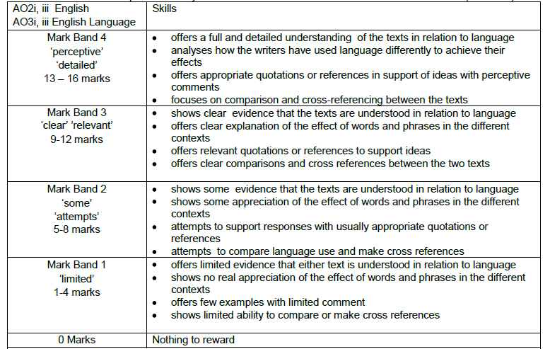

Slide 28
Section A – Top Tips
Read the questions before you read the texts
Highlight key words in the questions to make sure that you understand what the question is asking you to do
Make sure you highlight / annotate relevant parts of the texts as you are reading
Make sure you explain your ideas about the techniques used – remember the impact on the reader and the purpose of the text.

Slide 29
Section B: Writing
1 hour.
You will be asked two questions and should answer them both.
Q5: Inform / explain / describe, based on personal details: 16 marks. 25 minutes.
Q6: Argue / persuade / create a viewpoint which must be sustained: 24 marks. 35 minutes.

Slide 30
Assessment Objectives for Section B:
(i) Write to communicate clearly and effectively using and adapting forms and selecting VOCABULARY appropriate to task and purpose in ways that engage the reader.
(ii) Organise information and ideas into structured and sequenced sentences, PARAGRAPHS and whole texts, using a variety of structural features to support cohesion and overall coherence.
(iii) Use a range of SENTENCE STRUCTURES for clarity, purpose and effect, with accurate SPELLING and PUNCTUATION.
These are the same skills you have practised in your controlled assessments.

Slide 31
Make sure that you…
Show that you have understood the Type, Audience and Purpose for the writing
Use appropriate language, structure and presentational devices for the genre you have been given
Use appropriate and interesting vocabulary
Use a variety of appropriate connectives to link your ideas, sentences, and paragraphs
Use a variety of sentences effectively, varying your sentence openings
Make sure your work is accurate, using a full range of punctuation
Use paragraphs to help make your meaning clear

Slide 32
As well as noticing these things in Q4, you can use them in Q5 & Q6…
Adjectives
direct address (‘you’)
Word choice
Statistics
Repetition
Lists
Proper nouns
Facts
First person (‘I’)
Technical or subject specific words
Anecdotes
Personification
Onomatopoeia
Interesting verbs and adverbs
Personal opinions and feelings
Senses
Alliteration
Metaphor and simile
Using comparison
Statement/declarative sentences
rhetorical question
hyperbole

Slide 33
Q5 vs Q6
16 marks:
24 minutes
24 marks:
36 minutes
Examiners often comment that this question is ‘overwritten’.
This question is worth more than any other on the exam paper. Do it before Q5 to ensure you do it justice.

Slide 34
Q5: Inform / explain / describe, based on personal details: 16 marks. 25 minutes.
10 marks – use of language and detail; writing appropriately for audience and purpose; use of paragraphs
6 marks – spelling, punctuation, and sentence structure; use of standard English
Spend 25 minutes on this question
Aim to plan and write 1-2 sides.
Identify purpose and audience before you start.

Slide 35
Question 5
Describe:
Use your senses – colour, size, smells, weather, place etc.
Similes, metaphors, personification etc.
Vivid language – adjectives, adverbs
Verbs to create contrasts, bold pictures
DO BOTH!!!
Explain:
What, where, why, when and who.
Structure:
Engaging opening
Shorter paragraphs that follow on/link
Mix of sentence lengths and openers
Bold ending (link to the start)
TOP TIP
Use source 3 as a style model: it describes and explains.
Don’t forget 1/3 of the marks for this paper are for spelling, grammar and punctuation. Watch out for basic errors!

Slide 36
5. A website called We Did It!, which focuses on inspirational stories by teenagers, is asking for contributions. Write an entry for it which describes an achievement or accomplishment you are proud of. Explain how you overcame any difficulties or obstacles in your way.
Use appropriate and interesting vocabulary
Use a variety of appropriate connectives to link your ideas, sentences, and paragraphs
Use a variety of sentences effectively, varying your sentence openings
Make sure your work is accurate, using a full range of punctuation
Use paragraphs to help make your meaning clear

Slide 37
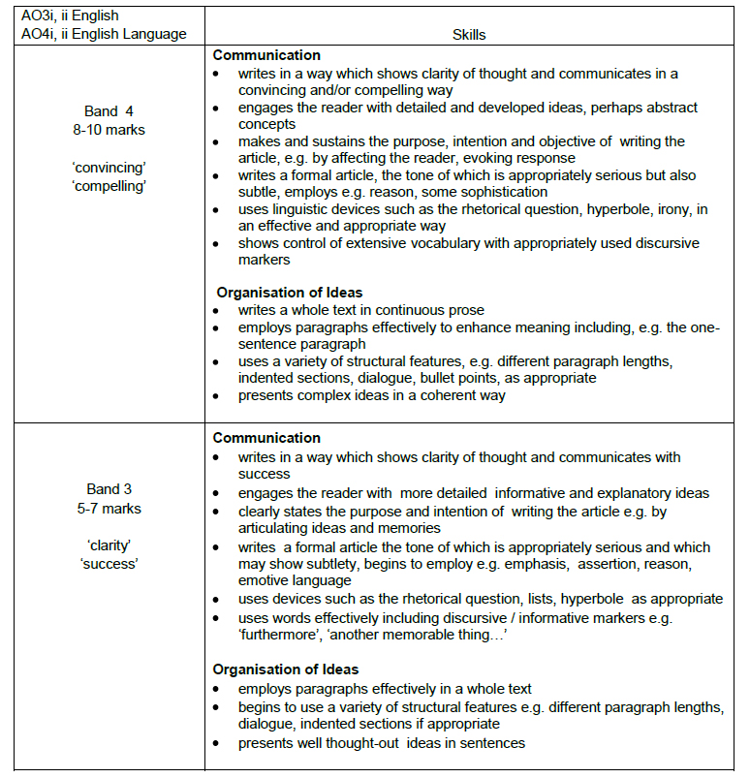

Slide 38
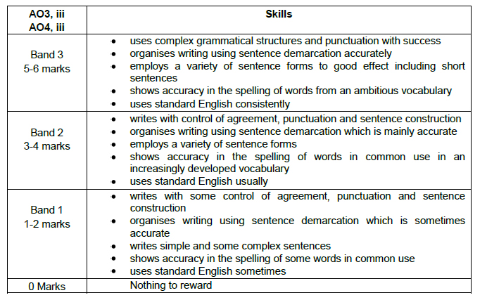

Slide 39
Q6: Argue / persuade / create a viewpoint which must be sustained: 24 marks. 35 minutes.
16 marks – use of language and detail; writing appropriately for audience and purpose; use of paragraphs
8 marks – spelling, punctuation, and sentence structure; use of standard English
Spend 35 minutes on this question
Aim to plan and write at least 2 sides.
Identify purpose and audience before you start.
Do this question before Q5! It’s worth more and is more difficult.

Slide 40
Question 6
Persuade:
Rhetorical questions, repetition, contrasts etc.
Use imagery and emotive language to involve your reader.
Direct address; lists of three; imperatives; punctuation for impact!
Argue:
Burgers – remember to acknowledge the opposite point of view.
Facts, statistics etc. to build up confidence of your reader.
Structure:
Short, motivating opening.
Include/acknowledge other points of view.
Support your points with evidence.
End with impact.
Shorter paragraphs.
TOP TIP
Use source 1 as a style model: it will present an argument about a topic.
Don’t forget 1/3 of the marks for this paper are for spelling, grammar and punctuation. Watch out for basic errors!

Slide 41
6. “Sports stars are good role models for young people.”
Write an article for a magazine of your choice arguing for or against this view.
Remember to:
Write an article
Argue your point of view
Use appropriate and interesting vocabulary
Use a variety of appropriate connectives to link your ideas, sentences, and paragraphs
Use a variety of sentences effectively, varying your sentence openings
Make sure your work is accurate, using a full range of punctuation
Use paragraphs to help make your meaning clear

Slide 42
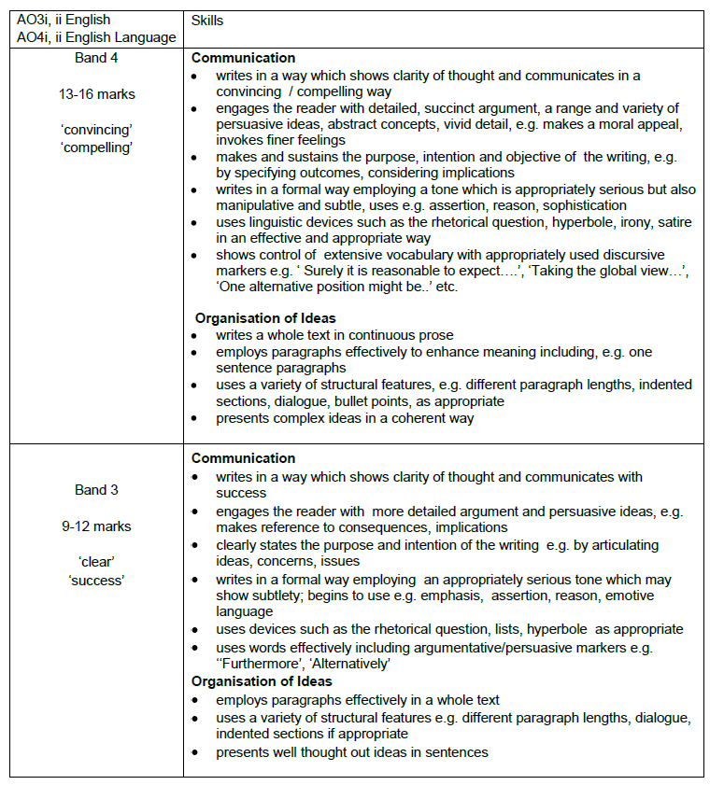

Slide 44
Top Tips for Section B
Read the question carefully.
Underline key words. Identify Type, Audience and Purpose.
Plan your answer to make sure you use appropriate structure, presentational devices and language.
Write your response, using your plan, and keep purpose, audience and form in mind.
Check your answer carefully – look for errors in sentences, paragraphing, spelling and punctuation.

